Slide 1
UNIT-2
Database Design using ER Model

Slide 2
Introduction to Database Design
Describe a real-world enterprise in terms of the data stored in a DBMS
The database design process can be divided into six steps
Requirements Analysis
Conceptual Database Design
Logical Database Design
Schema Refinement
Physical Database Design
Security Design
The ER model is most relevant to the First three steps

Slide 3
Requirements Analysis
what data is to be stored in the database
what applications must be built on top of it
what operations are most frequent and subject to performance requirements
find out what the users want from the database
an informal process that involves discussions with user groups
a study of the current operating environment
how it is expected to change
analysis of any available documentation on existing applications that are expected to be replaced or complemented by the database

Slide 4
Conceptual Database Design
The information gathered in the requirements analysis step is used to develop a high-level description of the data to be stored in the database along with the constraints
This step is often carried out using the ER model, or a similar high-level data model

Slide 5
Logical Database Design
choose a DBMS to implement our database design
convert the conceptual database design into a database schema in the data model of the chosen DBMS
the task in the logical design step is to convert an ER schema into a relational database schema

Slide 6
Schema Refinement
analyze the collection of relations in our relational database schema to identify potential problems, and to refine it
schema refinement can be guided by some elegant and powerful theory
normalizing relations

Slide 7
Physical Database Design
we must consider typical expected workloads that our database must support and further refine the database design to ensure that it meets desired performance criteria
This step may simply involve
Building indexes on some tables
clustering some tables
it may involve a substantial redesign of parts of the database schema obtained from the earlier design steps

Slide 8
Security Design
we identify different user groups and different roles played by various users
development team
support representatives
product manager
For each role and user group
we must identify the parts of the database that they must be able to access
and the parts of the database that they should not be allowed to access
and take steps to ensure that they can access only the necessary parts

Slide 9
The Entity-Relationship Model
ER model developed to facilitate database design by allowing specification of an enterprise schema that represents the overall logical structure of a database
The E-R data model employs three basic concepts:
entity sets,
attributes, and
relationship sets

Slide 10
Entity-Relationship Diagram
The E-R model also has an associated diagrammatic representation, the E-R diagram
An E-R diagram can express the overall logical structure of a database graphically
E-R diagrams are simple and clear

Slide 11
ENTITIES, and ENTITY SETS
Entity
Real-world object distinguishable from other objects
An entity is described (in DB) using a set of attributes.
Entity Set:
A collection of similar entities.
E.g., all employees.
Entity sets need not be disjoint
All entities in an entity set have the same set of attributes
Attributes reflects the level of detail at which we wish to represent information about entities

Slide 12
Attributes
For each attribute associated with an entity set, we must identify a domain of possible values
An attribute can be characterized by the following attribute types
Simple and composite
Simple attribute are not divided into subparts
Composite attributes can be divided into subparts
Single-valued and multi-valued
have a single value for a particular entity
an attribute has a set of values for a specific entity

Slide 13
Derived attribute
The value for this type of attribute can be derived from the values of other related attributes or entities
EX: loans-held
An attribute takes a null value when an entity does not have a value for it
The null value may indicate “not applicable”—that is, that the value does not exist for the entity

Slide 14
ER diagram consists of the following major components:
Rectangles, which represent entity sets
Ellipses, which represent attributes
Diamonds, which represent relationship sets
Lines, which link attributes to entity sets and entity sets to relationship sets
Double ellipses, which represent multi valued attributes
Dashed ellipses, which denote derived attributes
Double lines, which indicate total participation of an entity in a relationship set
Double rectangles, which represent weak entity sets

Slide 15
The Employees entity set with attributes
ssn (Social Security Number)
name
lot (Parking lot)
An entity set is represented by a rectangle, and an attribute is represented by an oval
Each attribute in the primary key is underlined
The domain information could be listed along with the attribute name
name
ssn
lot
Employees

Slide 16
Relationships and Relationship Sets
A relationship is an association among two or more entities
A relationship set is a set of relationships of the same type
Formally, it is a mathematical relation on n ≥ 2 (possibly non distinct) entity sets.
If E1, E2, . . .,En are entity sets, then a relationship set R is a subset of
{(e1, e2, . . . , en) | e1 ∈ E1, e2 ∈ E2, . . . , en ∈ En}
where (e1, e2, . . . , en) is a relationship

Slide 17
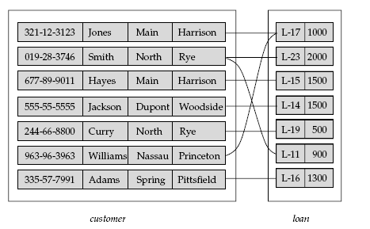
A Relationship set Borrower
the relationship set borrower to denote the association between customers and the bank loans that the customers have.

Slide 18
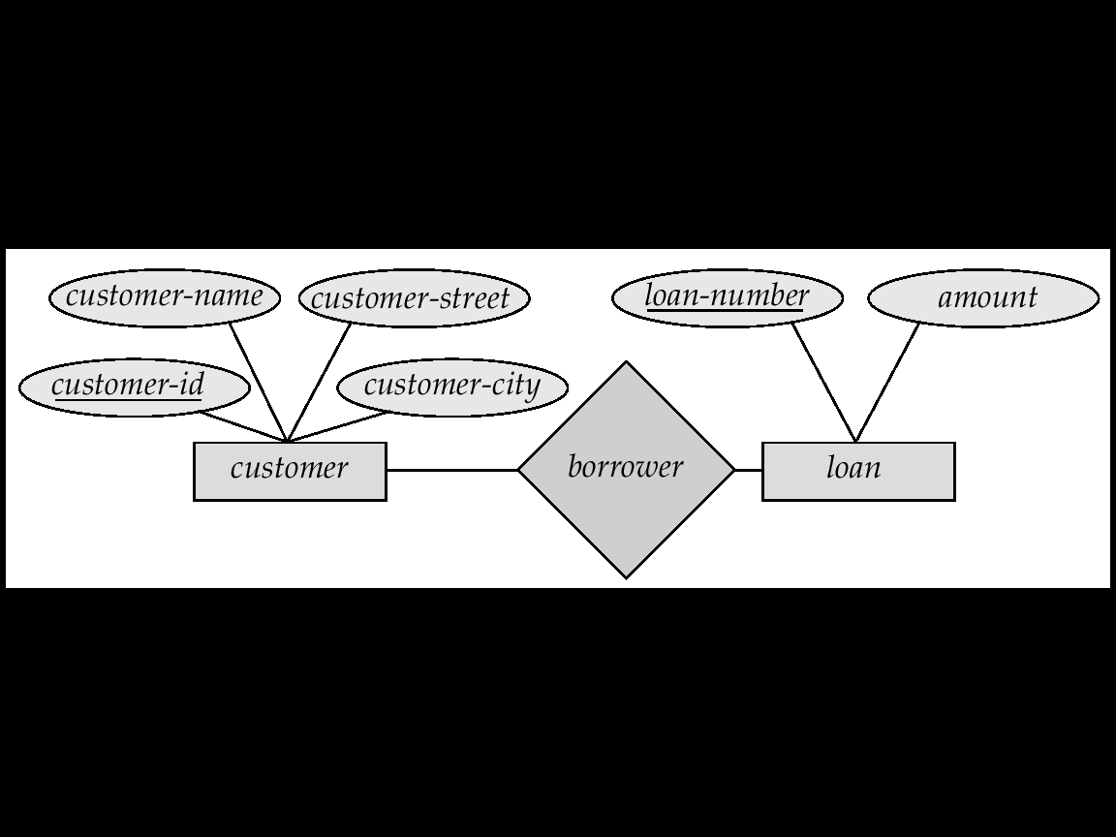
E-R diagram for
Relationship set Borrower

Slide 19
The association between entity sets is referred to as participation
the entity sets E1, E2, . . .,En participate in relationship set R
A relationship instance in an E-R schema represents an association between the named entities in the real-world enterprise that is being modeled
loan entity L-15 participate in a relationship instance of borrower

Slide 20
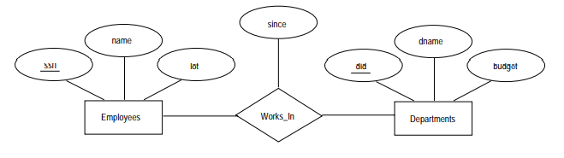
An attribute can also be property of a relationship set
Descriptive attributes : A relationship can also have its own attributes to record information about the relationship

Slide 21
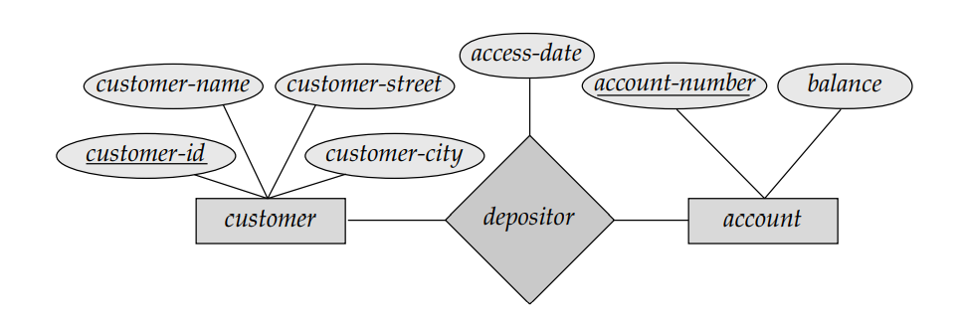
the depositor relationship set between entity sets customer and account may have the attribute access-date

Slide 22
Degree of a Relationship Set
Refers to number of entity sets that participate in a relationship set
Relationship sets that involve two entity sets are binary (or degree two).
Relationship sets may involve more than two entity sets.
Suppose employees work at multiple branches, with different jobs at different branches.
Then there is a ternary relationship set between entity sets employee, department and location

Slide 23
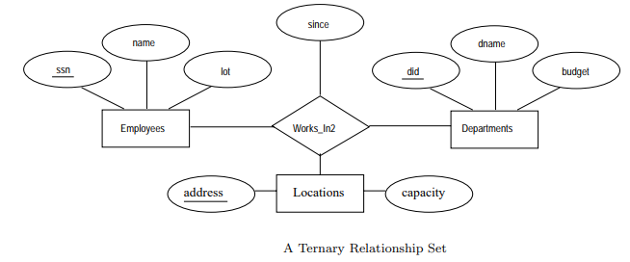

Slide 24
E-R Diagrams

Slide 25
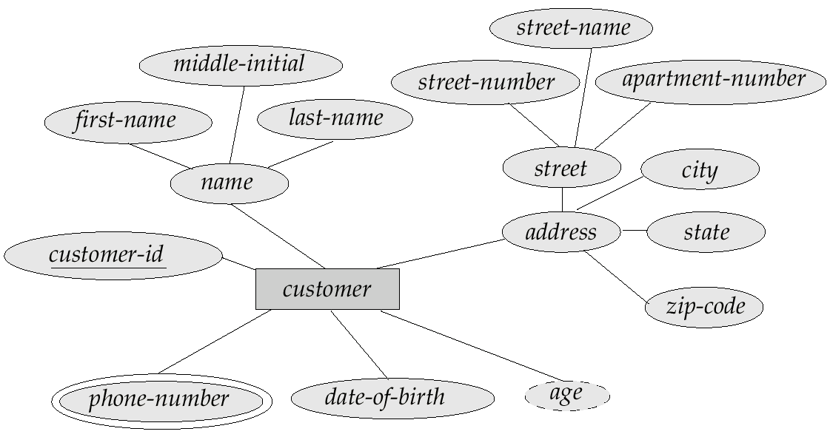
E-R Diagram With Composite, Multivalued, and Derived Attributes

Slide 26
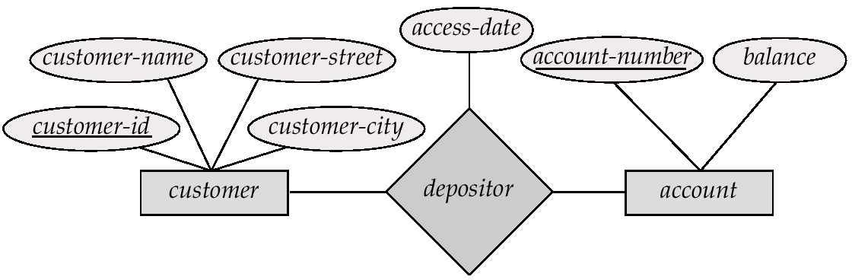
Relationship Sets with Descriptive Attributes

Slide 27
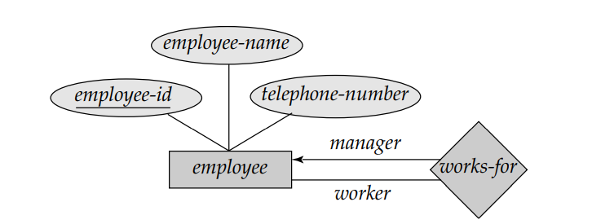
E-R Diagram with role indicators
We indicate roles in E-R diagrams by labeling the lines
the role indicators manager and worker between the employee entity set and the works-for relationship set

Slide 28
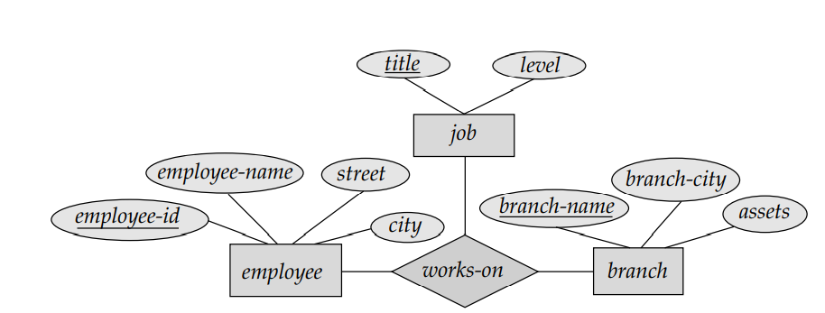
E-R Diagram with ternary relationship

Slide 29
Mapping Cardinalities
Express the number of entities to which another entity can be associated via a relationship set.
Most useful in describing binary relationship sets.
For a binary relationship set the mapping cardinality must be one of the following types:
One to one
One to many
Many to one
Many to many

Slide 30
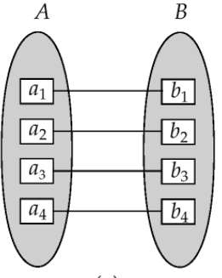
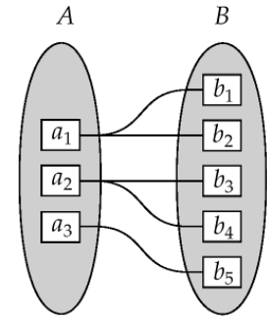
One-to-one:
An entity in A is associated with at most one entity in B,
and an entity in B is associated with at most one entity in A
One-to-many:
An entity in A is associated with any number (zero or more) of entities in B.
An entity in B, however, can be associated with at most one entity in A

Slide 31
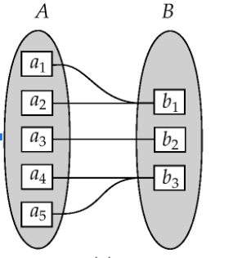
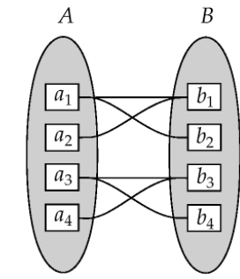
Many-to-one:
An entity in A is associated with at most one entity in B.
An entity in B, however, can be associated with any number (zero or more) of entities in A.
Many-to-Many:
An entity in A is associated with any number (zero or more) of entities in B,
and an entity in B is associated with any number (zero or more) of entities in A.

Slide 32
Cardinality Constraints
We express cardinality constraints by drawing either a directed line (→), signifying “one,”
or an undirected line (—), signifying “many,” between the relationship set and the entity set.

Slide 33
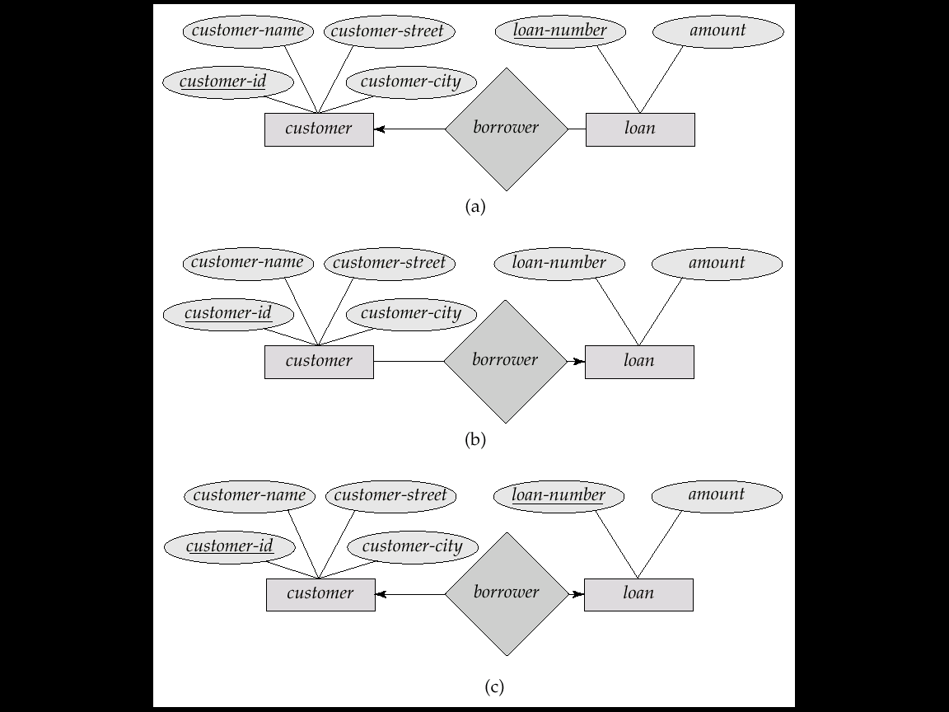
One-to-One relationship:
A customer is associated with at most one loan via the relationship borrower
A loan is associated with at most one customer via borrower

Slide 34
One-To-Many Relationship
In the one-to-many relationship a loan is associated with at most one customer via borrower, a customer is associated with several (including 0) loans via borrower

Slide 35
Many-To-One Relationships
In a many-to-one relationship a loan is associated with several (including 0) customers via borrower, a customer is associated with at most one loan via borrower

Slide 36
Many-To-Many Relationship
A customer is associated with several (possibly 0) loans via borrower
A loan is associated with several (possibly 0) customers via borrower

Slide 37
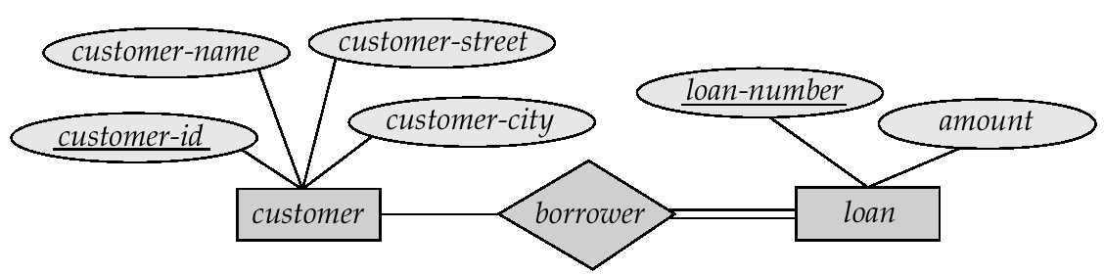
Participation of an Entity Set in a Relationship Set
Total participation (indicated by double line): every entity in the entity set participates in at least one relationship in the relationship set
E.g. participation of loan in borrower is total
every loan must have a customer associated to it via borrower
Partial participation: some entities may not participate in any relationship in the relationship set
E.g. participation of customer in borrower is partial

Slide 38
since
since
name
dname
dname
ssn
did
did
budget
lot
budget
Employees
Manages
Departments
Works_In
since

Slide 39
KEYS
A key allows us to identify a set of attributes that suffice to distinguish entities from each other
Keys also help to uniquely identify relationships, and thus distinguish relationships from each other.

Slide 40
A superkey is a set of one or more attributes that, taken collectively, allow us to identify uniquely an entity in the entity set
For example
the customer-id attribute of the entity set customer is sufficient to distinguish one customer entity from another. Thus, customer-id is a superkey
Similarly, the combination of customer-name and customer-id is a superkey for the entity set customer.
The customer-name attribute of customer is not a superkey, because several people might have the same name.

Slide 41
minimal subset of superkeys are called candidate keys
superkeys for which no proper subset is a superkey
Example:
{customer-id} and
{customer-name, customer-street}
Although the attributes customerid and customer-name together can distinguish customer entities, their combination does not form a candidate key,
attribute customer-id alone is a candidate key

Slide 42
Although several candidate keys may exist, one of the candidate keys is selected to be the primary key.
Primary Key is a unique and non-null key which identify entities uniquely in an entity set.
A entity can have only one primary key
The primary key should be chosen such that its attributes are never, or very rarely, changed

Slide 43
Keys for Relationship Sets
The combination of primary keys of the participating entity sets forms a super key of a relationship set.
(customer-id, account-number) is the super key of depositor
NOTE: this means a pair of entity sets can have at most one relationship in a particular relationship set.
Must consider the mapping cardinality of the relationship set when deciding the what are the candidate keys
Need to consider semantics of relationship set in selecting the primary key in case of more than one candidate key

Slide 44
Weak Entity Sets
An entity set that does not have a primary key is referred to as a weak entity set
A Weak entity can be identified uniquely by considering some of its attributes in conjunction with the primary key of another entity , which is called the identifying owner
Restrictions
The owner entity and the weak entity set must participate in a one-to-many relationship set
i.e one owner entity set is associated with one or more weak entity sets , but each weak entity set has a single owner
The weak entity set have total participation in the identifying relationship set

Slide 45
The set of attribute of a weak entity set that uniquely identify a weak entity for a given owner entity is called a partial key(/discriminator) of the weak entity set
We depict a weak entity set by double rectangles.
We underline the discriminator of a weak entity set with a dashed line.
payment_number – discriminator of the payment entity set
Primary key for payment – (loan_number, payment_number)

Slide 46
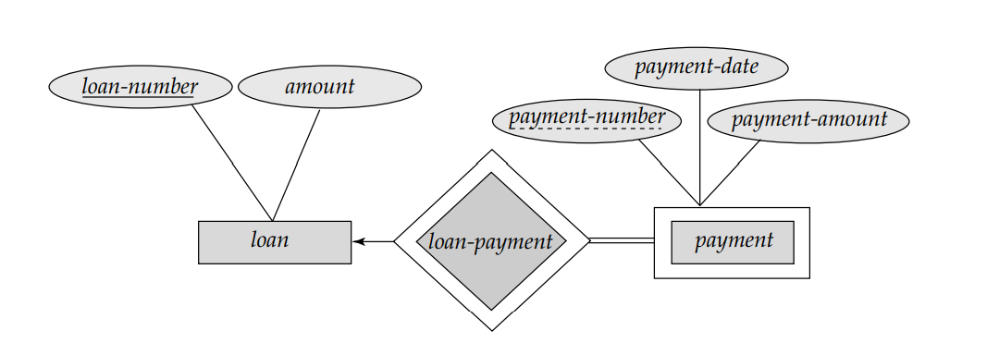
E-R diagram with a weak entity

Slide 47
Additional Features of ER Model
Key Constraints
Participation Constraints
weak Entities
class Hierarchies
Aggregation

Slide 48
Class Hierarchies
Specialization: The process of identifying subsets of an entity set
Generalization: Process of identifying common characteristics of a collection of entity sets and creating a new entity set

Slide 49
Consider an entity set person, with attributes name, street, and city.
A person may be further classified as one of the following:
customer
employee
The specialization of person allows us to distinguish among persons according to whether they are employees or customers
Specialization is a top-down approach in which a higher-level entity is divided into multiple specialized lower-level entities.

Slide 50
Generalization is a bottom-up approach, in which multiple entity sets are synthesized into a higher-level entity set on the basis of common features
Generalization is used to emphasize the similarities among lower-level entity sets and to hide the differences;
Higher- and lower-level entity sets also may be designated by the terms superclass and subclass, respectively
generalization is a simple inversion of specialization.

Slide 51
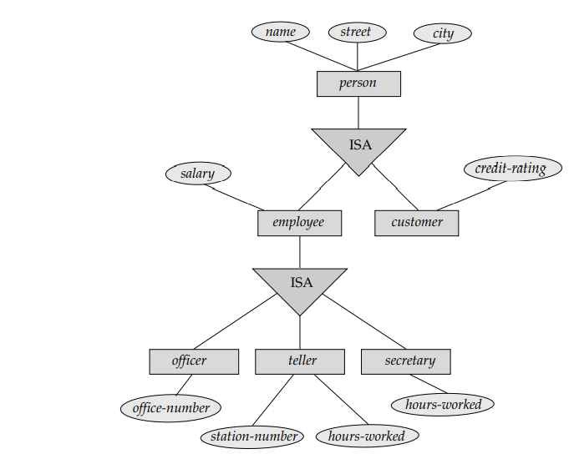
Specialization and Generalization

Slide 52
name
ssn
lot
Employees
hourly_wages
hours_worked
ISA
contractid
Hourly_Emps
Contract_Emps

Slide 53
Attribute Inheritance
A crucial property of the higher- and lower-level entities created by specialization and generalization is attribute inheritance.
The attributes of the higher-level entity sets are said to be inherited by the lower-level entity sets.
Example:
customer and employee inherit the attributes of person.
A higher-level entity set with attributes and relationships that apply to all of its lower-level entity sets
Lower-level entity sets with distinctive features that apply only within a particular lower-level entity set

Slide 54
Disjoint: A disjointness constraint requires that an entity belong to not more than one lower-level entity set.
Overlapping the same entity may belong to more than one lower-level entity set within a single generalization.
Total generalization or specialization: Each higher-level entity must belong to a lower-level entity set.
Partial generalization or specialization: Some higher-level entities may not belong to any lower-level entity set.

Slide 55
Aggregation
To model a relationship between a collection of entities and relationships
Aggregation allows us to indicate that a relationship set participates in another relationship set
Suppose that we have an entity set called Projects and that each Projects entity is sponsored by one or more departments.
The Sponsors relationship set captures this information
A department that sponsors a project might assign employees
to monitor the sponsorship
a dashed box around Sponsors (and its participating entity sets) used to denote aggregation.

Slide 56
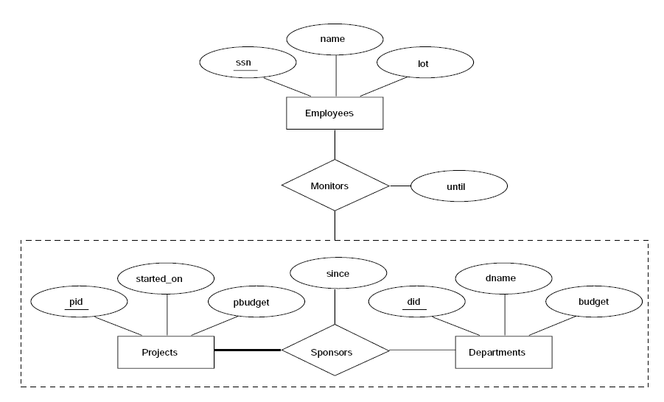
we use Aggregation when we need to express a relationship among relationships

Slide 57
CONCEPTUAL DATABASE DESIGN WITH THE ER MODEL
Developing an ER diagram presents several choices
Should a concept be modeled as an entity or an attribute?
Should a concept be modeled as an entity or a relationship?
Identifying relationships: Binary or ternary? Aggregation?

Slide 58
Entity vs. Attribute
Should address be an attribute of Employees or an entity (connected to Employees by a relationship)?
Depends upon the use we want to make of address information, and the semantics of the data:
If we have several addresses per employee, address must be an entity (since attributes cannot be set-valued).
If the structure (city, street, etc.) is important,
e.g., we want to retrieve employees in a given city, address must be modeled as an entity (since attribute values are atomic).

Slide 59
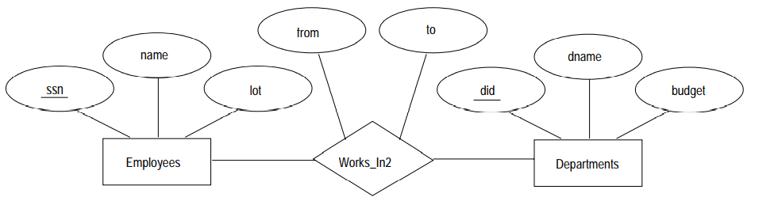
records the interval during which an employee works for a department
Works_In2 does not allow an employee to work in a department for two or more periods.

Slide 60
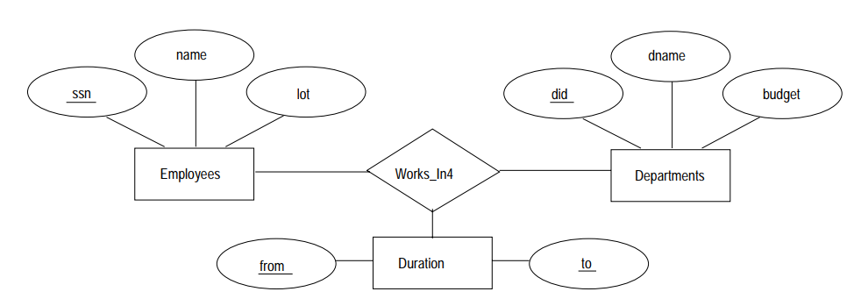
Similar to the problem of want to record several addresses for an employee: we want to record several values of the descriptive attributes for each instance of this relationship.

Slide 61
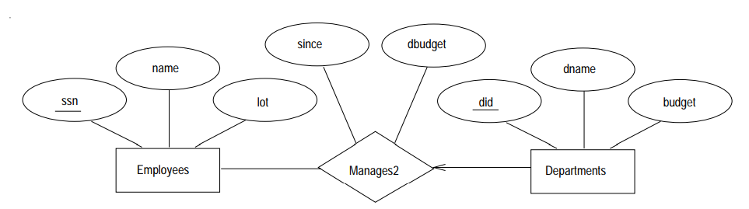
Entity vs. Relationship
There is at most one employee managing a department, but a given employee could manage several departments
we store the starting date and discretionary budget for each manager-department pair
This approach is natural if we assume that a manager receives a separate discretionary budget for each department

Slide 62
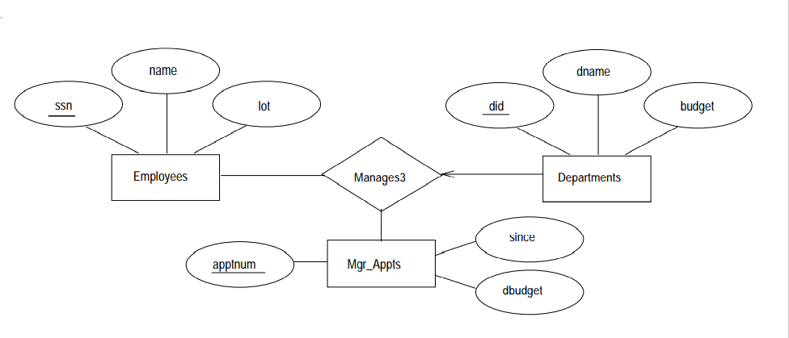
What if a manager gets a discretionary budget that covers all managed depts?
Redundancy of dbudget, which is stored for each dept managed by the manager.
we model the appointment as an entity set, say Mgr Appt, and use a ternary relationshipset

Slide 63
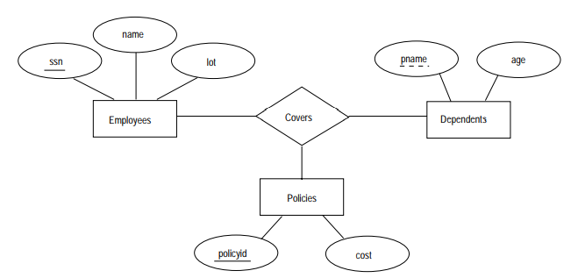
Binary vs. Ternary Relationships
Employee can own several policies, each policy can be owned by several employees, and each dependent can be covered by several policies

Slide 64
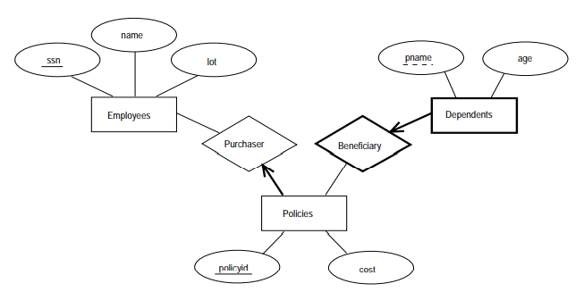
Suppose that we have the following additional requirements:
policy cannot be owned jointly by two or more employees
Every policy must be owned by some employee
Dependents is a weak entity set, and each dependent entity is uniquely identified by taking pname in conjunction with the policyid of a policy entity

Slide 65
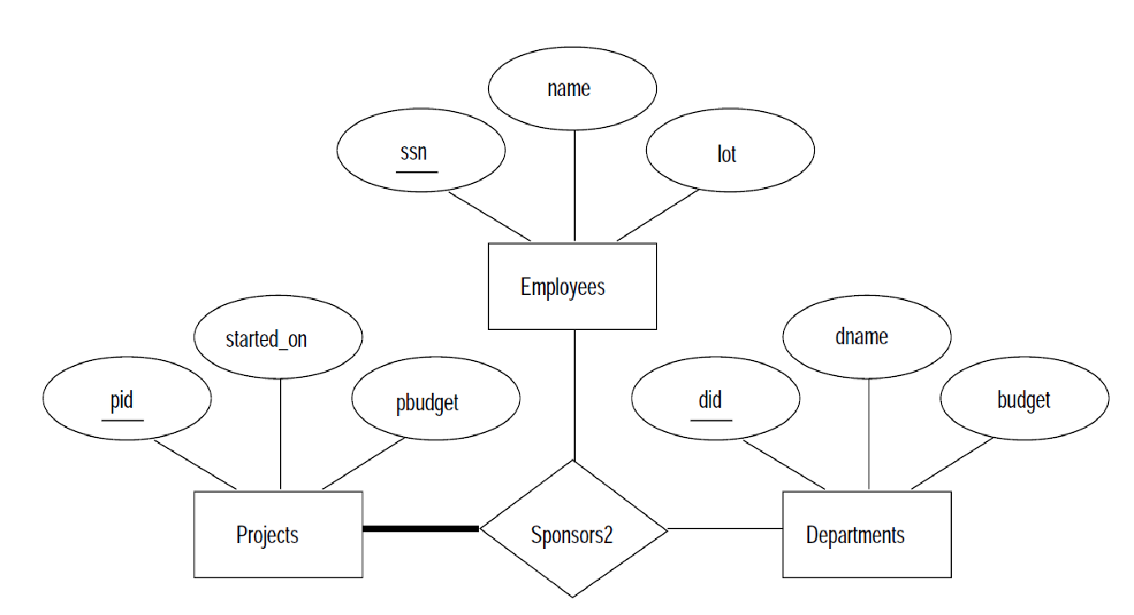
Aggregation Vs Ternary Relationships
If we don't need to record the until attribute of Monitors, then we might reasonably use a ternary relationship

